Slide 1



Systems Biology - BMS 473 - Team 1 project presentation
DE NOVO DESIGN OF
PROTEIN LOGIC GATES
Dr. Mohammed ElGamacy
Alaa Mohamed 202101529
Hanin Gamal 202101061
Hayam Waleed 202100281
Nader Hany 201901347

Slide 2

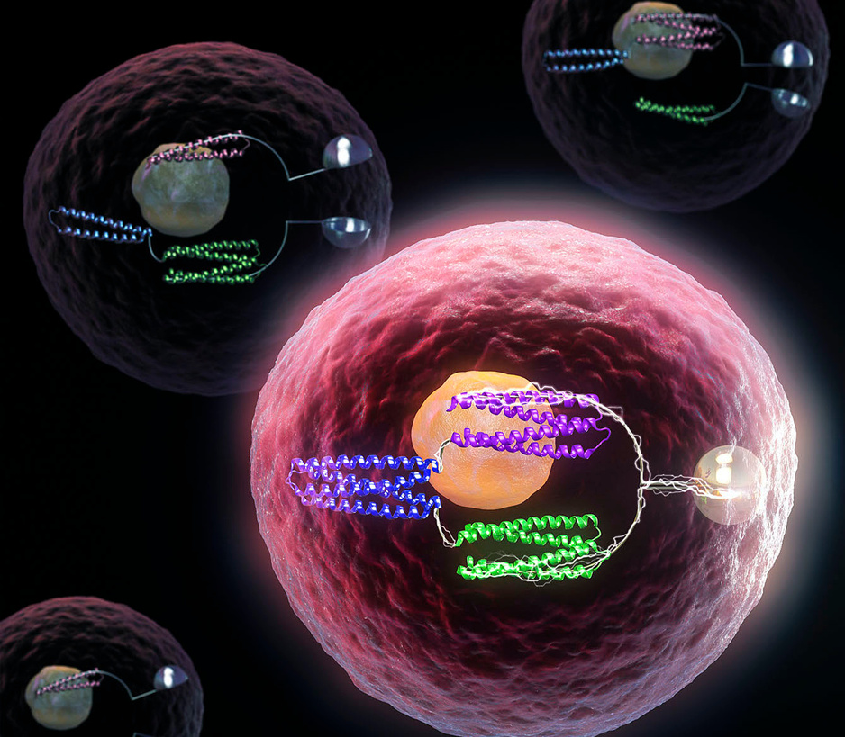
Introduction
Protein-protein interactions are crucial for cellular decision-making and synthetic biology, though most efforts have focused on DNA, transcription, or RNA-based control [1].
Regulating protein function posttranscriptionally is a significant challenge in synthetic biology.
Current protein-based circuits are limited by a small pool of building blocks, restricting scalability.

Slide 3
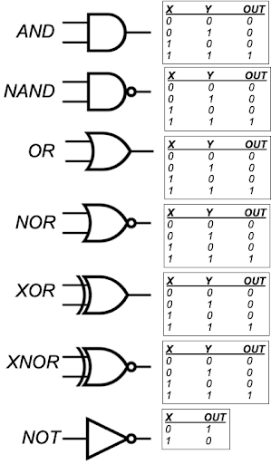
Introduction
De novo logic gates designed from heterodimeric proteins could enable scalable protein-based control systems.
Regulating protein function posttranscriptionally is a significant challenge in synthetic biology.
Developed logic gates (AND, OR, NAND, NOR, XNOR, NOT) using custom-designed proteins.
Gates control protein associations (e.g., split enzymes, transcriptional machinery) in various systems, including yeast and human T cells.

Slide 4
Introduction
Binding interactions are cooperative, as confirmed by native mass spectrometry.
Gates are resistant to imbalances in input stoichiometry (cooperativity).
This approach allows extensions to more complex logic gates like three-input OR, AND, and disjunctive normal form gates.
Also, this enables advanced control over biological functions through flexible design methods.

Slide 5
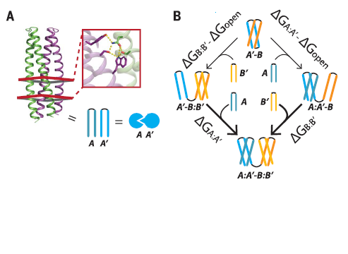
Methods
Building blocks require orthogonality (independent pairs), modularity (similar structures), tunable binding specificities, and cooperativity (insensitivity to stoichiometric imbalances).
Sets of mutually orthogonal designed heterodimers (DHDs, referred to by characters / numbers, e.g., A and A′ form one cognate pair) with hydrogen bond network-mediated and shared topology were created.
Cooperative monomer fusions are designed to ensure selective gate activation by allowing for interaction surfaces.

Slide 6
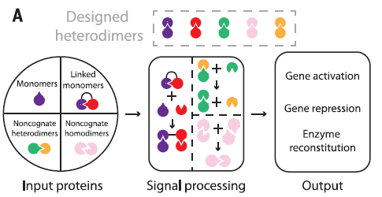
Methods
Experiments optimized linker lengths for stability and folding, with lengths of 6-12 residues performing best.
The following logic gates, composed of different combinations of compounds, are each represented in differential equations form in a python code.
The solution of each gate’s components is plotted using a visualization function.

Slide 7
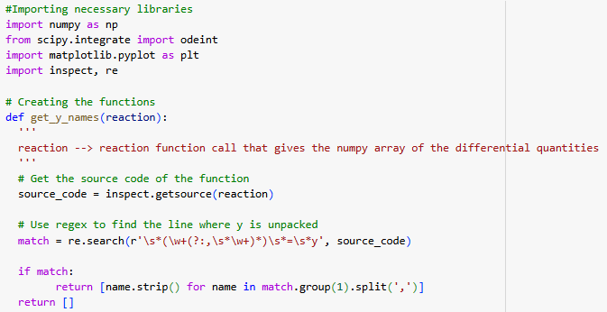
Methods
Visualization Function:

Slide 8
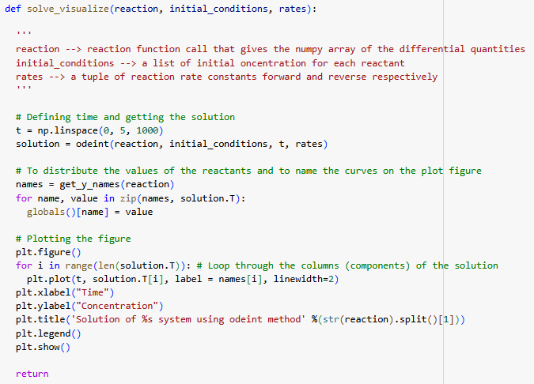
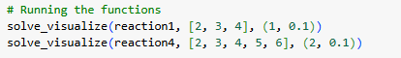
Methods
Visualization Function:

Slide 9
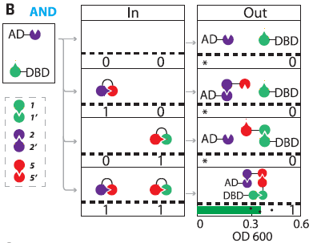
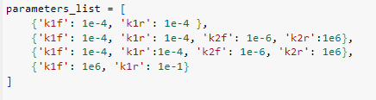
Results
1) 2-input AND gate

Slide 10
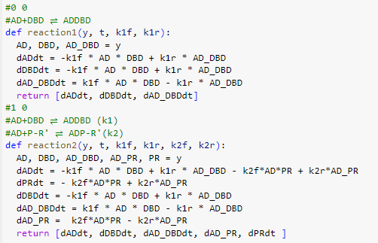
Results
1) 2-input AND gate

Slide 11
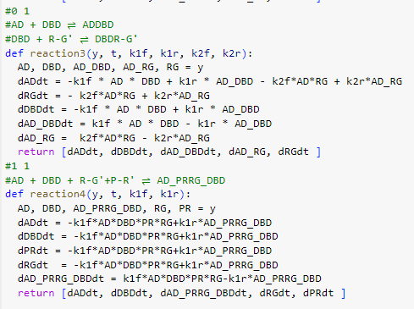
Results
1) 2-input AND gate

Slide 12
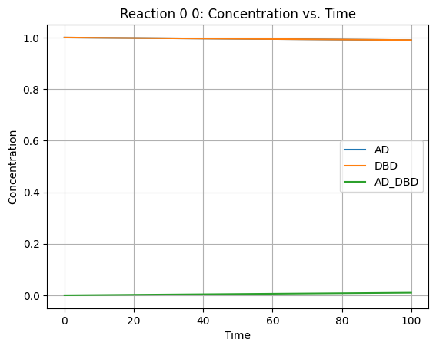
Results
1) 2-input AND gate

Slide 13
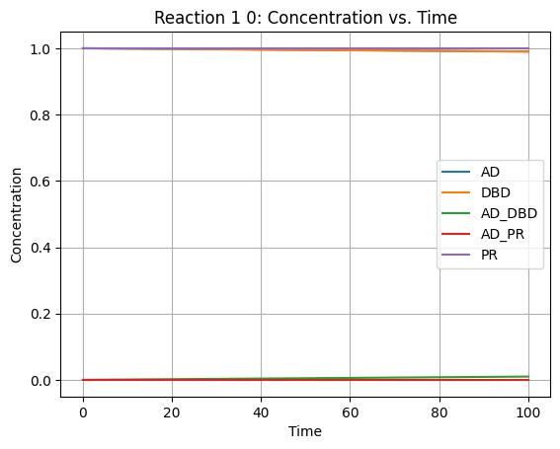
Results
1) 2-input AND gate

Slide 14
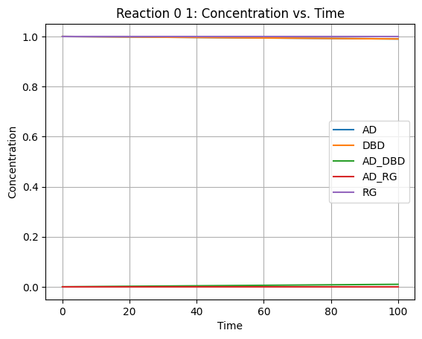
Results
1) 2-input AND gate

Slide 15
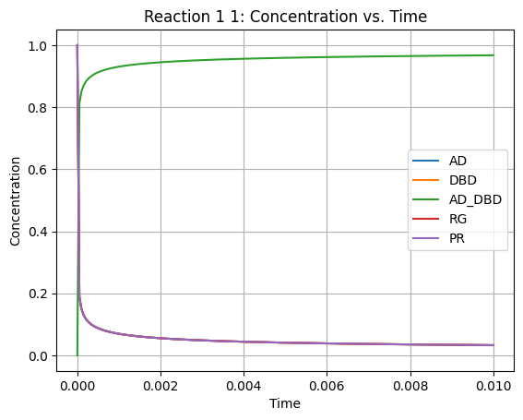
Results
1) 2-input AND gate

Slide 16
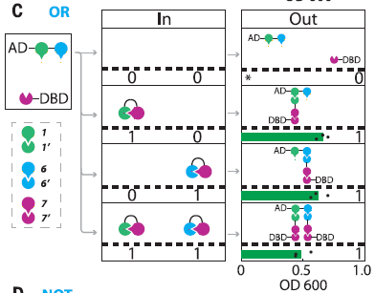
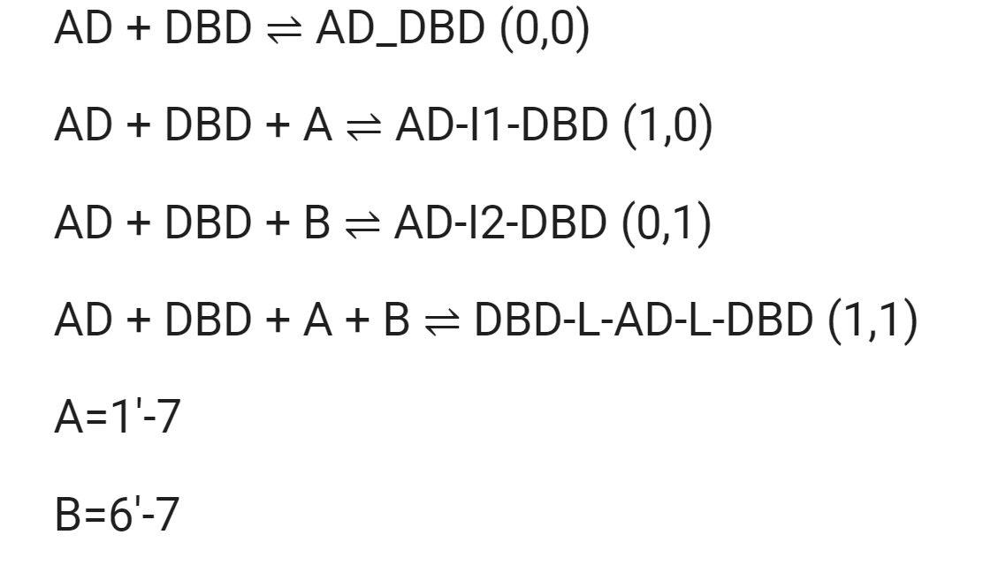
Methods
3) 2-input OR gate

Slide 17
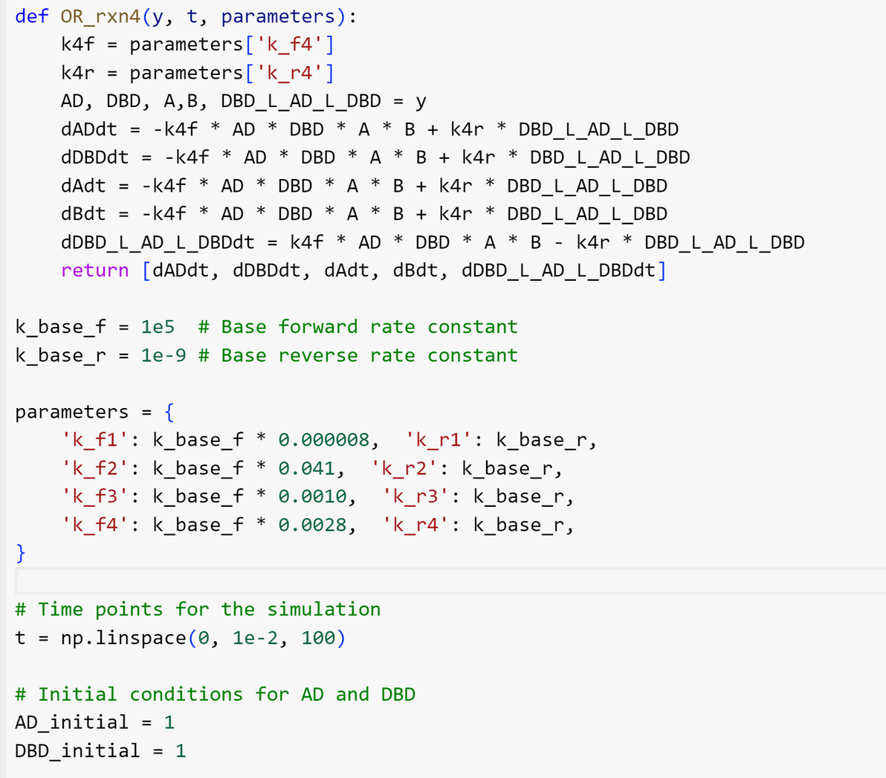
Methods
3) 2-input OR gate

Slide 18
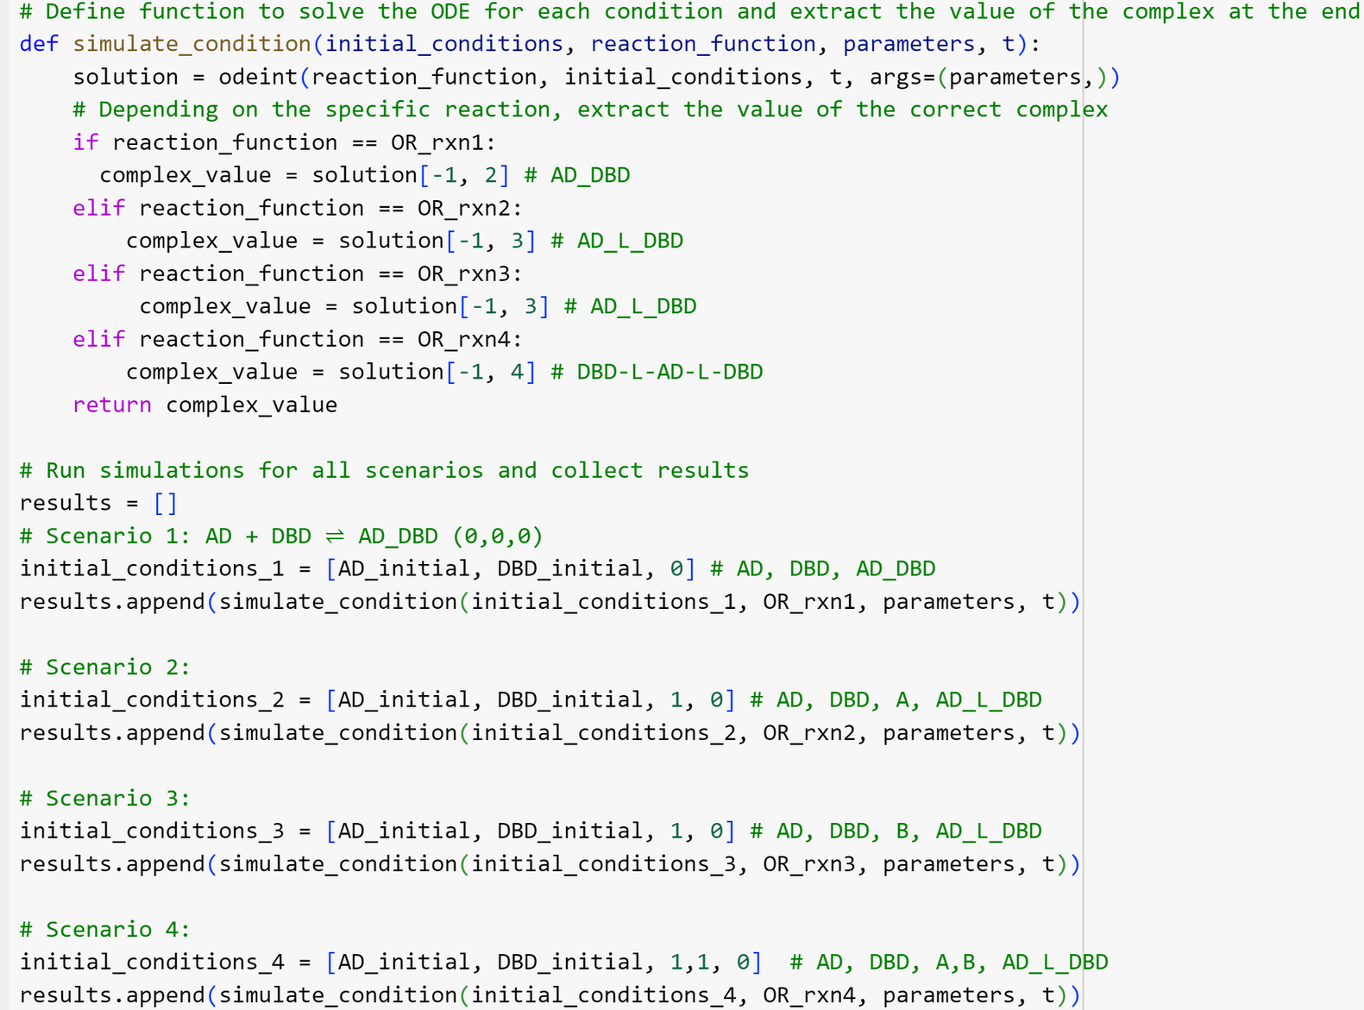
Methods
3) 2-input OR gate

Slide 19
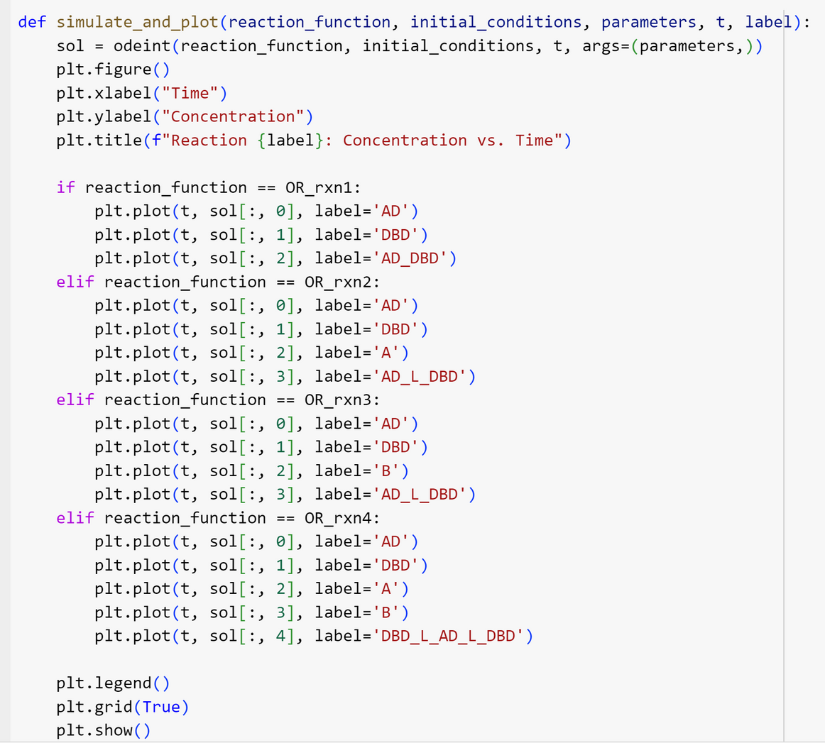
Methods
3) 2-input OR gate

Slide 20
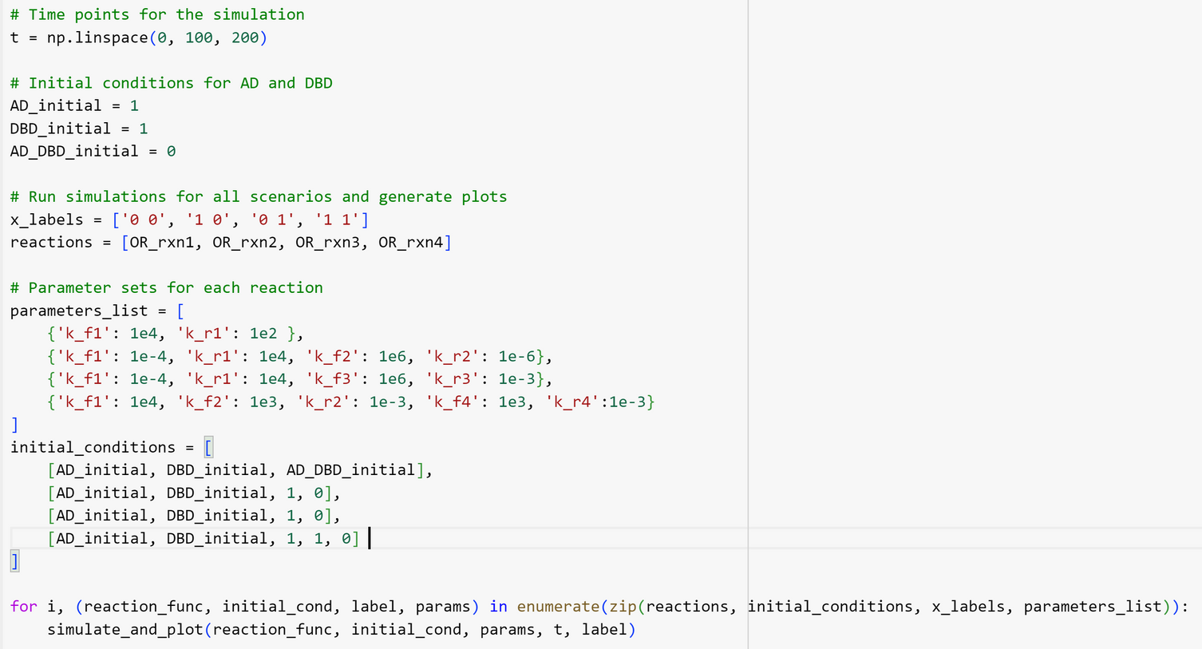
Methods
3) 2-input OR gate

Slide 21
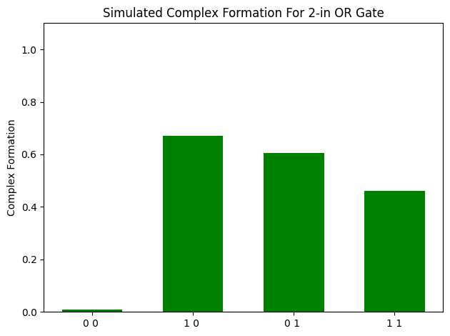
Results
2) 2-input OR gate

Slide 22
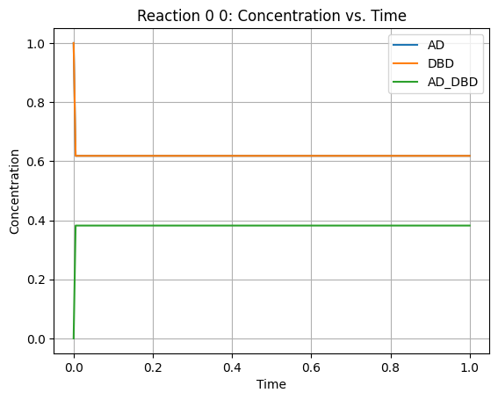
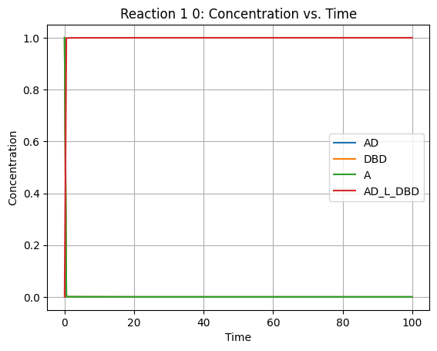
Results
2) 2-input OR gate

Slide 23
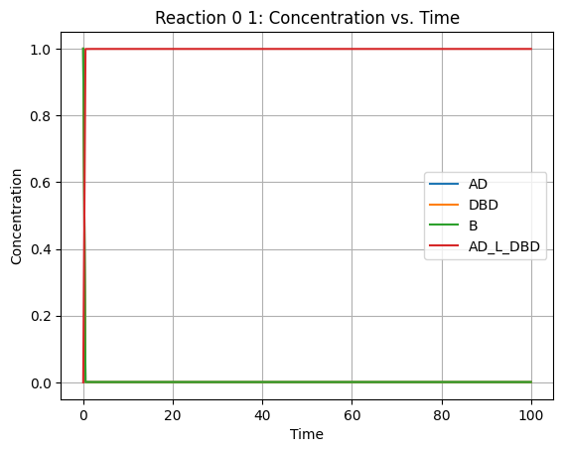
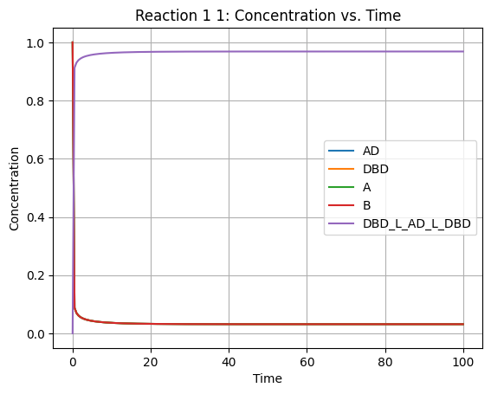
Results
2) 2-input OR gate

Slide 24
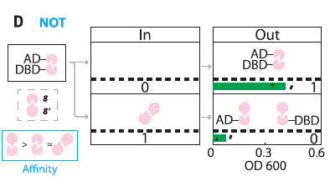
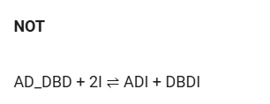
Methods
3) 2-input NOT gate

Slide 25
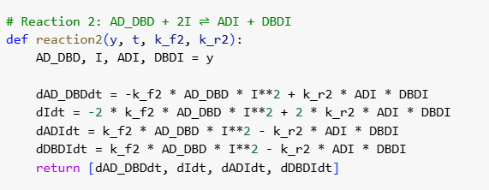
Methods
3) 2-input NOT gate

Slide 26
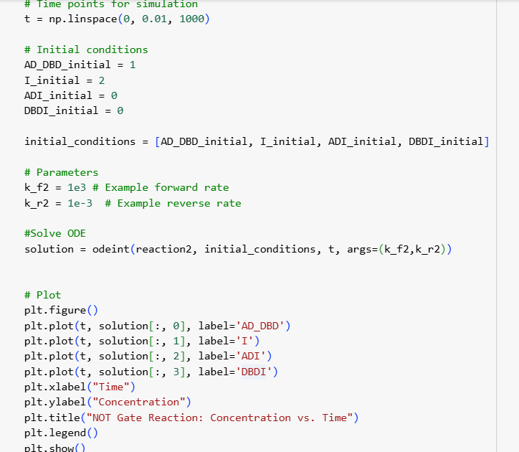
Methods
3) 2-input NOT gate

Slide 27
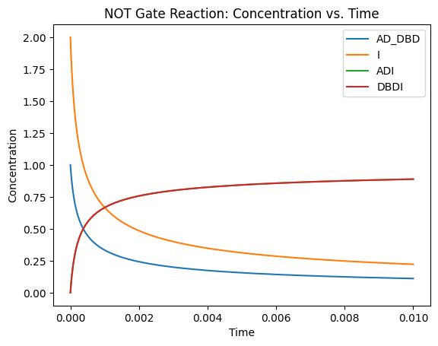
Results
3) 2-input NOT gate

Slide 28
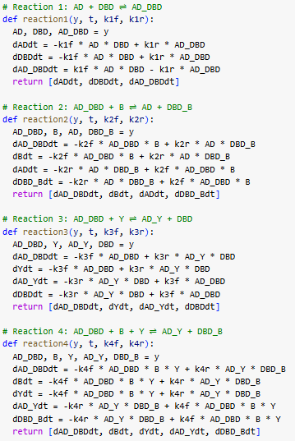
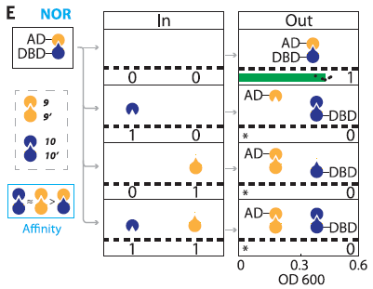
Results
4) 2-input NOR gate

Slide 29
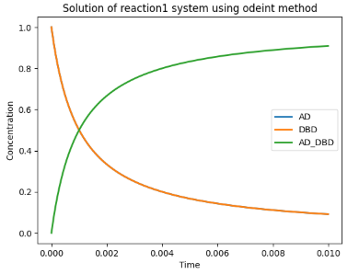
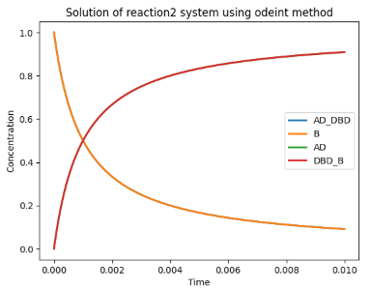
Results
4) 2-input NOR gate

Slide 30
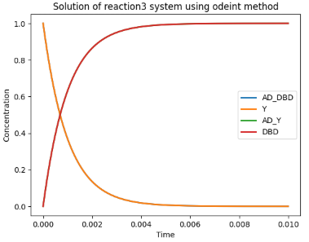
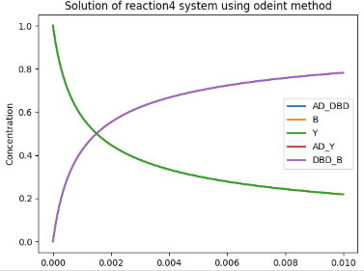
Results
4) 2-input NOR gate

Slide 31
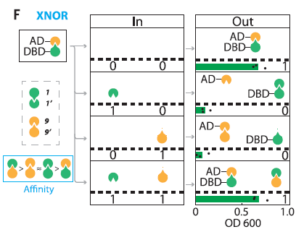
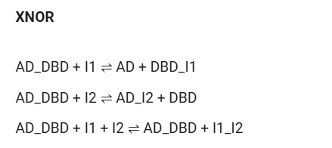
Methods
5) 2-input XNOR gate

Slide 32
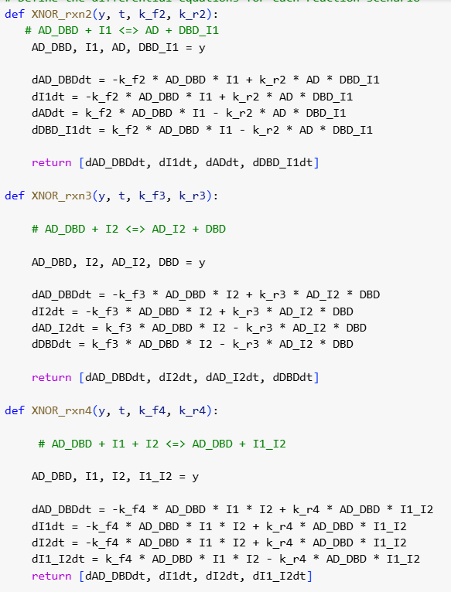
Methods
5) 2-input XNOR gate

Slide 33
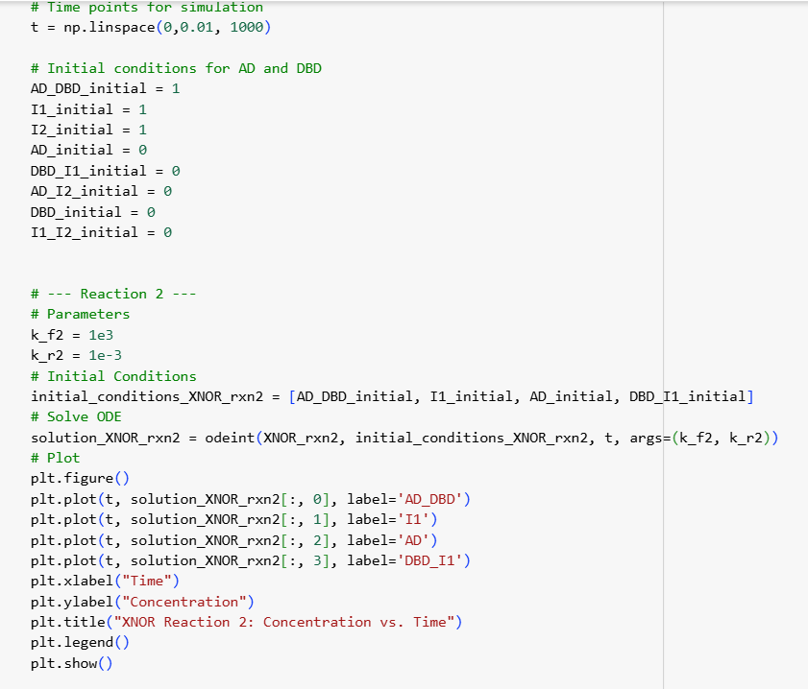
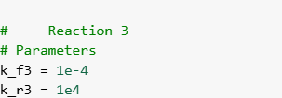
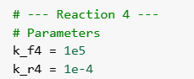
Methods
5) 2-input XNOR gate

Slide 34
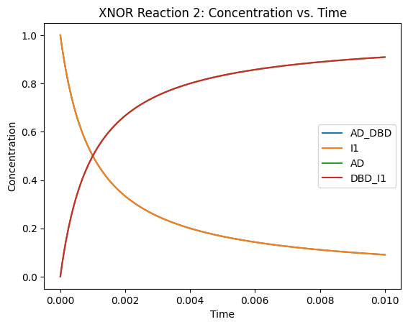
Results
5) 2-input XNOR gate

Slide 35
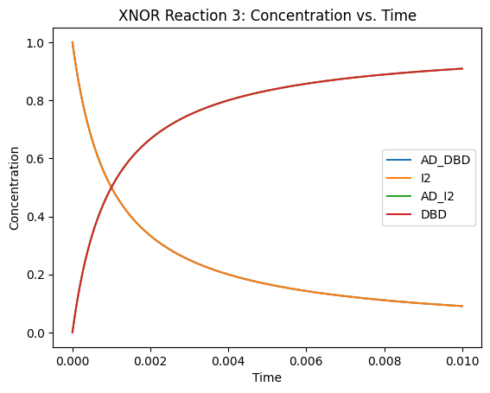
Results
5) 2-input XNOR gate

Slide 36
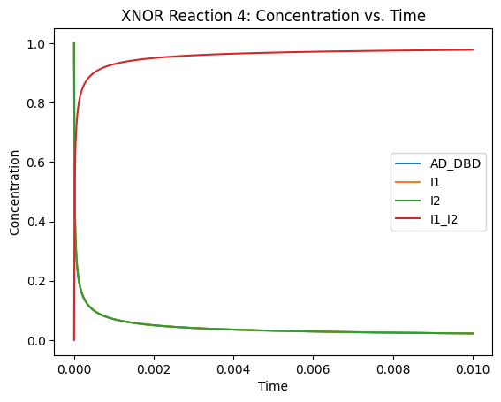
Results
5) 2-input XNOR gate

Slide 37
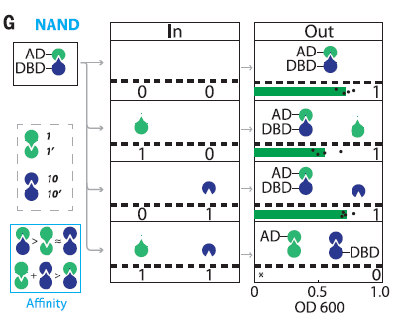
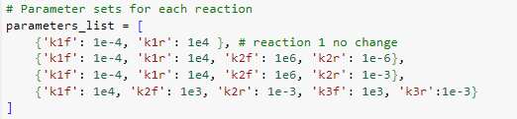
Results
6) 2-input NAND gate

Slide 38
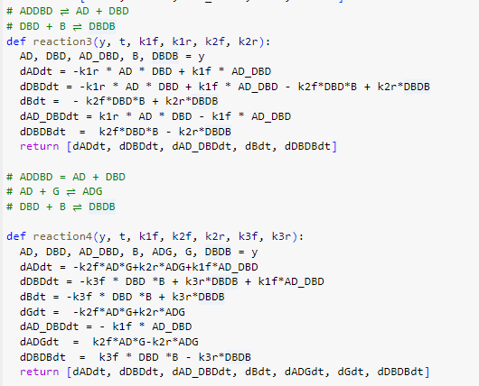
Results
6) 2-input NAND gate

Slide 39
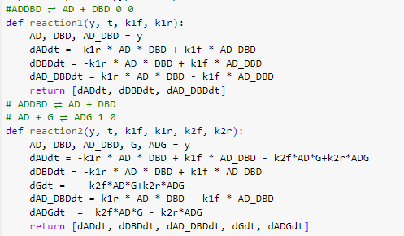
Results
6) 2-input NAND gate

Slide 40

Results
6) 2-input NAND gate

Slide 41

Results
6) 2-input NAND gate

Slide 42

Results
6) 2-input NAND gate

Slide 43

Results
6) 2-input NAND gate

Slide 44

Results
7) 3-input AND gate
AD+DBD ⇌ ADDBD - - -
AD+DBD+GY ⇌ AD_GY_DBD + - -
AD+DBD+YR ⇌ AD_GY_DBD - + -
AD+DBD+ RP ⇌ AD_RP_DBD - - +
AD+DBD+ YR+ GY ⇌ AD_RPGY_DBD + + -
AD+DBD+ RP+ GY ⇌ AD_RPGY_DBD + - +
AD+DBD+ RP+ YR ⇌ AD_RPYR_DBD - + +
AD+DBD+ RP+ GY + YR ⇌ AD_RPGY_DBD
+ + +

Slide 45


Slide 46

Results

Slide 47

Results

Slide 48

Results

Slide 49

Results

Slide 50

Results

Slide 51

Results

Slide 52

Results

Slide 53

Results

Slide 54

Results

Slide 55

Results

Slide 56

Results

Slide 57

Results

Slide 58


Methods
9) 3-input OR gate

Slide 59

Methods
9) 3-input OR gate

Slide 60

Methods
9) 3-input OR gate

Slide 61

Methods
9) 3-input OR gate

Slide 62


Methods
9) 3-input OR gate

Slide 63

Results
8) 3-input OR gate

Slide 64


Results
8) 3-input OR gate

Slide 65


Results
8) 3-input OR gate

Slide 66

Results
8) 3-input OR gate

Slide 67

Results
8) 3-input OR gate

Slide 68


Methods
9) 3-input DNF gate

Slide 69

Methods
9) 3-input DNF gate

Slide 70

Methods
9) 3-input DNF gate

Slide 71


Methods
9) 3-input DNF gate
https://www.sciencedirect.com/science/article/pii/S0968000417301603

Slide 72

Methods
9) 3-input DNF gate
Simulation function

Slide 73

Methods
9) 3-input DNF gate
Storing the concentrations

Slide 74

Methods
9) 3-input DNF gate
Plotting

Slide 75

Results
9) 3-input DNF gate

Slide 76
Conclusion
De novo protein design enables the creation of numerous components with consistent topology, supporting complex logic gates based on competitive binding.
Designed hydrogen bond networks provide specificity and diverse binding affinities, enabling cooperative and scalable assemblies.

Slide 77
Conclusion
CIPHR gates can directly control diverse protein functions (e.g., transcriptional regulation, enzyme reconstitution) and operate in various environments without additional machinery.
The small size of DHDs and hyperstability make them suitable for mammalian cell engineering (e.g., T-cells) and circuit design.
The system offers unlimited repertoire of building blocks from de novo design.
The reactions representing each gate can be expressed of by using differential equations that can be solved computationally to further grasp the behavior of the reactants.

Slide 78
References
[1] Z. Chen et al., “De novo design of protein logic gates,” Science, vol. 368, no. 6486, pp. 78–84, Apr. 2020, doi: https://doi.org/10.1126/science.aay2790.
‌

Slide 79



THANK YOU

